Slide 1
Simlog Playback
Preeti Rathore
Garishta Madan
Ajay Yadav
Notes:
1

Slide 2
Agenda
Business Process & Application Mapping
OQS Simlog Functional Overview
OQS Simlog Technical Overview
OQS Simlog Operational Overview
OQS Simlog Ticket Information
OQS Simlog Inventory Status
2
Notes:
2

Slide 3
Important Terms
Discrepancy
Preflight
Device Status
Time log
Class Plan
Class Roster

Slide 4
OQS SIMLOG Functions
Maintains records for Simulation devices
Records Discrepancies
Records the daily check (“Preflight”)
Enters a “time log” of the training that is conducted in the simulators
Records if a simulator is “Status”
Manages Inventory– includes parts on the simulators and those in stock.
Reports

Slide 5
High Level Functional Elements
Level 1
Level 2
Level 3
Simlog
Training
Resource
Admin
Inventory
ATOM
Managing
Discrepancies
Add/Update
Or Delete
Parts
Managing
Device Status
Send/Receive
For repairing
Preflight
Manage
Vendors
Managing
Time Log

Slide 6
Resource Component
Level 1
Level 2
Level 3
Level 4
Simlog
Training Resource
Managing
Discrepancies
Managing
Device Status
Preflight
Managing
Time Log
Add
Search
Discrepancy
Manual Down to UP
Check Device
Before the
day Start
Add
Update
Manual UP to Down
Update
Close
extend
UP to down by batch job

Slide 7
Adding New Discrepancies
Add New Discrepancies
Discrepancies creator
Details :
(Employee Id & Name)
Discrepancies
Originator
Discrepancies Type
FAA Details :
Emp ID &
No of days to complete
Airport Code
&
Runway
Sim Period

Slide 8
Adding Time Log
Adding Time Log
Time Log Date
Sim Period
Start/End Time
Reviewer Details
Crew details/employee & Contractors

Slide 9
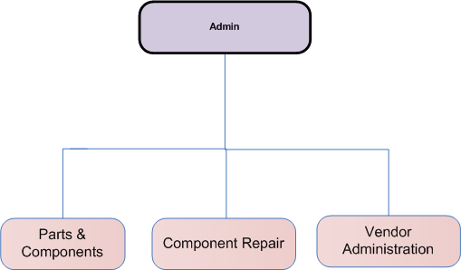
Admin Functions

Slide 10
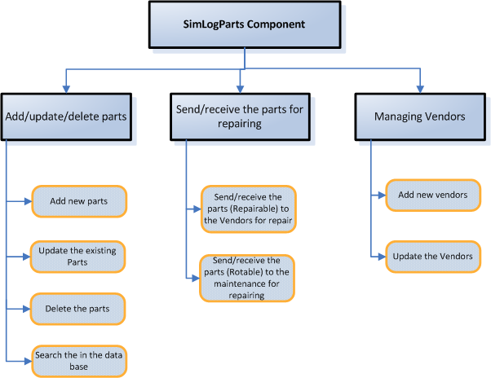
Parts and Components

Slide 11
Vendor Administration
Adding A Vendor
Vendor Type
(Consumables,
Aircraft Rotables
& Réparables)
Department
Vendor Name
Contact Details

Slide 12
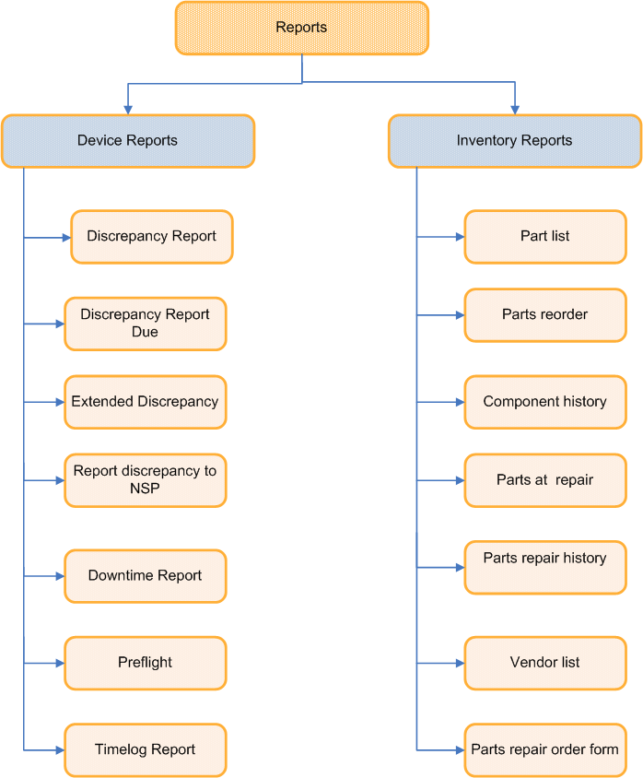
Reports:

Slide 13
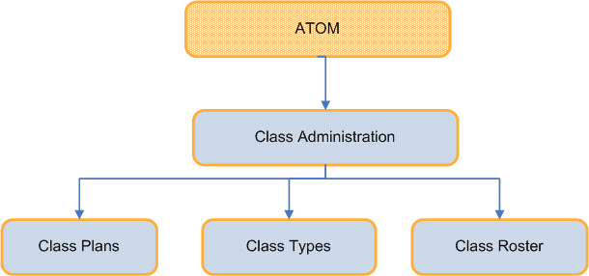
ATOM:

Slide 14
Vendor Administration
System Roles
Sim Tech
Flight Ops
Training Mgr
FO Sim
Instructor and
check Pilots
FFA
Instructor
In Flight User
Admin
ATOM
Admin
Completing
Pre flight
Adding
Discrepancies
Entering
the time log
Crew training
Event in sim
Adding
Discrepancies
Completing
Pre flight (IF)
Manage
Component
repair
Add/update
Class Plan
Changing
Device status
Extending
Discrepancies
Reviewing
Open
Discrepancies
Changing
Device status
(for IF)
Adding
Discrepancies
Modifying
original
Discrepancies
information
Manage
vendors
Add/update
Class Roster
Adding
Discrepancies
Adding
Discrepancies
(for IF)
Adding
corrective
Action for
discrepancies
Adding
corrective
Action for IF
discrepancies
Extending
Discrepancies
Extending
Discrepancies
(for IF)
Relocating parts
And components

Slide 15
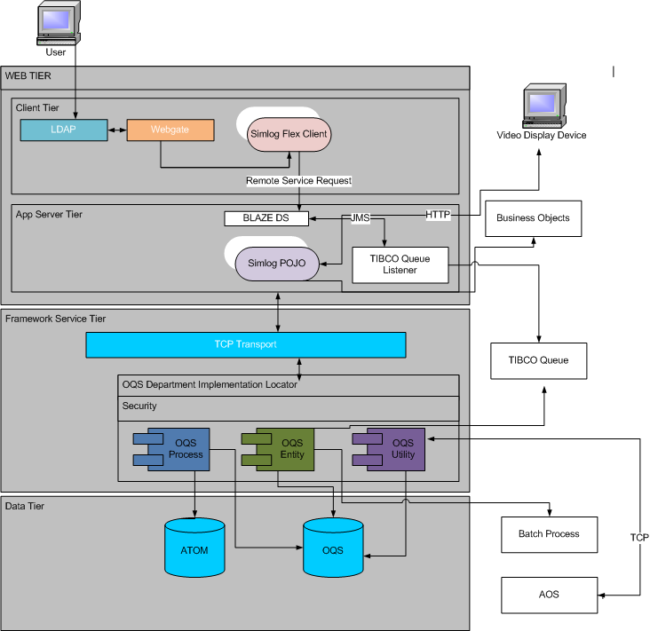
OQS Simlog Technical Diagram
15
Notes:
15

Slide 16
OQS Simlog - Batch Process
Simlog Batch Jobs
Update Resource
Status
At 12:05 AM
System check all
open discrepancies for
the simulators if any due
date passed status will
turn to down if it is UP
Update Preflight
At 4:05 AM
System set all devices
Status ready for
preflight
16

Slide 17
Simlog Server Information
 | Environment / Servers
 | PROD | SDC | SAT | ITEST | DEV | ETL
Websphere / i.e. Application Servers | xlpwas07/08/09 | xlswas01 | xlqwas03/04 | xltwas03/04 | xldwas06
Frameworks/Mule same as RK | xspsvc21 xspsvc22 | xspsvc15 xspsvc16 | xsqsvc07 xsqsvc08 | xstsvc01 xstsvc02 | xsdsvc05 xsdsvc06
AOS - Our service is called 'Enterprise Facility Service' version 1.6.0. |  |  | xlqsvc03/04 |  | xldsvc03/04/05/06/07
Batch | xspbat01 |  | xsqsvc01 xsqsvc02
Web Servers | xspweb09/10 | xspweb08 | xsqweb11/12 | xstweb15 | xsdweb01
OQS database | SHRTFRP xlprac11 xlprac12 | SHRTFRP xlsrac09 xlsrac10 | SHRTFRQ xlqodb05 xlqodb06 | SHRTFRD OQS_ADMIN xldodb01 xldodb02 xldodb03 xldodb04 | SHRTFRD OQS_DEV_ADMIN xldodb01 xldodb02 xldodb03 xldodb04
BO Servers | swara.swacorp.com ms2boe11 – 18, msboe19 – 20 |  | swaraqa.swacorp.com msqaboe11 – 15 | swaradevt.swacorp.com Alpha: swaradeva.swacorp.com | swaradev.swacorp.com msdevboe01 – 04

Slide 18
OQS Simlog Operational Information
Application Usage (Client Perceptive)
24 Hours/day including weekends
Quarterly Maintenance Releases
OQS-Simlog is “Critical To Business” Application.
SOX Compliance – NA PCI Compliance – NA
Critical Incident Report - None Reported BCP Event - None Reported
18
Notes:
18

Slide 19
OQS Simlog Ticket Information
Parameter | Urgent | High | Medium | Low
Yearly Ticket (based on 2010 data) | 0 | 11 | 4 | 11
Queue Name – OQS Support
Majority of Tickets are from iTops Monitoring system.
URGENT/HIGH/MEDIUM tickets are paged and LOW tickets are emailed.
19
Notes:
19

Slide 20
OQS Simlog Inventory Status
Parameter | Details
Technical Documentation
Functional Documentation
Operational Documentation
Database Technology (and version) | Oracle 10G
Web Server | Tomcat 5.5
Front End | Flex
Production Server(s)/Mule Servers | xlpwas07/08/09/xspsvc21, xspsvc22
Production Database(s) | SHRTFRP/xlprac11/xlprac12
Production BO Server(s) | swara.swacorp.com /ms2boe11 – 18, msboe19 – 20
QA Server(s)/Mule Servers | xlqwas03/04/xsqsvc07, xsqsvc08
QA Database(s) | SHRTFRQ/xlqodb05/xlqodb06
QA BO Server(s) | swaraqa.swacorp.com msqaboe11 – 15
ITest Server(s)/Mule Server | xltwas03/04/xstsvc01, xstsvc02
ITest Database(s) | SHRTFRD OQS_ADMIN/xldodb01/xldodb02/xldodb03/xldodb04
ITest BO Server(s) | swaradevt.swacorp.com Alpha:swaradeva.swacorp.com
Dev Server(s)/Mule Server | xldwas06/xsdsvc05, xsdsvc06
Dev Database(s) | SHRTFRD OQS_DEV_ADMIN/xldodb01/xldodb02/xldodb03/xldodb04
Dev BO Server | swaradev.swacorp.com / msdevboe01 – 04
Source Code Repository & Configuration Mgmt | Clearcase
Developer's Toolset
Code Generation Tool | Free marker
Release Schedule
20
Notes:
20

Slide 21
Thanks
Notes:
21

